Slide 1
Career Development Training Course
Career Waypoints
Professional Apprenticeship Career Track (PACT)

Slide 2
Enabling Objectives
STATE the purpose of Career Waypoints
LIST the personnel impacted by the Career Waypoints process
DEFINE the Career Waypoints process
LIST the Career Waypoints options provided to the Sailor
ASSESS the Career Waypoints timeline requirements
EXPLAIN the PACT Career Waypoints and PACT Marketplace process
Notes:
FACILITATOR GUIDE:
Review objectives.

Slide 3
References
Navy Military Personnel Manual, NAVPERS 15560 (Series)
MILPERSMAN 1160-140, Career Waypoints-Reenlistment​
MILPERSMAN 1001-260, Targeted Re-Entry Program
NAVPERS 15878 (series), Career Counselor Handbook
Career Waypoints (CWAY) User Guide
MILPERSMAN 1306-611, Professional Apprenticeship Career Track
MILPERSMAN 1236-010, Armed Forces Classification Test (AFCT) Administration and Procedures for Navy Personnel
Notes:
FACILITATOR GUIDE:
Review references.

Slide 4
Purpose of Career Waypoints (CWAY)
Force Management tool
Provides conversion opportunities
Centralized reservation system
Enables Sailors to make more informed decisions
Controls reenlistment and extension quotas
Notes:
FACILITATOR GUIDE:
Career waypoints (CWAY) is a force shaping tool which assists with balancing manning across rates, ratings through BUPERS control of reenlistment and enlistment contract extension quotas.
It provides conversion opportunities and enables Sailors to make more informed decisions.
NOTE: Sailors can now apply for conversion in the Marketplace located in My Navy Assignment (MNA). (preferred method)

Slide 5
Personnel Impacted by C-WAY
Rated E3 to E6 AC/TAR Sailors
Applies to Sailors with 14 years of active service or less as calculated from ADSD to SEAOS:
CWAY automatically generates most reenlistment applications based on Sailors' PRD or SEAOS (whichever comes first)
Special circumstance CWAY applications can be made (e.g., SRB or STAR purposes)
PACT Sailors desiring to become rated
Selected Reserve Sailors:
Can apply for lateral conversions
Apply to change from Reserve Component to Active Component
Notes:
FACILITATOR GUIDE:
CWAY automatically generates most reenlistment applications (keep in mind for special circumstances such as SRB you will have to manually apply) for Active Component (AC) and Training & Administration of the Reserves (TAR) Sailors.
CWAY is also where you go if a Sailor decides to transition from Active Component to Selective Reserves or vice versa.
An approved CWAY quota is required for rated E3-E6 Sailors with less than 14 years of service from their ADSD and SEAOS in order to reenlist.

Slide 6
Counselor Responsibilities
Qualify Sailors in C-WAY (CWAY User Guide p. 14)
Review and/or submit applications in CWAY monthly
Ensure 100% on-time submission
Notes:
FACILITATOR GUIDE:
Deadline for application submission is 2359 Central Standard Time on the last day of each month. At 18 months CWAY auto populates applications, 16 months Sailor's application for SEAOS are processed and at 15 months prior to the Sailor's PRD (whichever is first).

Slide 7
CWAY/PRD Timeline
Notes:
FACILITATOR GUIDE:
Explain timelines.

Slide 8
CWAY Homepage
Notes:
FACILITATOR GUIDE:
1. Once logged into the home page for CWAY, (found on BOL) in the middle of the screening CWAY populates notes, i.e. if a specific month reenlistment results have been released or any other important information.
2. To pull individual Sailors, hover over Sailors, Sailor browser and find Sailor (listed in alphabetical order based off last name). To get to the reenlistment applications prepopulated for the month, hover over Sailors, reenlistment then click reenlistment application browser. Here you can see which Sailors' applications have been submitted. You can change the from/to date to a single month and click on the refresh button highlighted in blue.

Slide 9
CWAY Notes Section
Notes:
FACILITATOR GUIDE:
1. To either input notes or see if ECM has made any notes (reminder the notes section is where you as the CCC can communicate to the ECM), hover over Sailors, Sailor browser, may need to change page size of 25 to 500 in order to show all Sailors based on the UIC(s) access you have and find the Sailor you are looking for. Click on Sailor's name to get it highlighted in blue, then click on notes. This is where you add or view notes to the Sailor's ECM.
2. Remember this section is your opportunity to communicate with the ECM. Ensure to add notes for applications that are special circumstance, not eligible, and no apply (document everything that affects a change in the Sailor’s application).
3. In this example, the CCC made changes to the Sailor's AFCT scores and annotated the reason why she made said changes.

Slide 10
CWAY Qualify/Apply Reenlistment
Notes:
FACILITATOR GUIDE:
1. To qualify or manually input a reenlistment application, hover over Sailors, Sailor browser, find Sailor you are looking for, highlight in blue then click edit on left hand side. On this screen you will click on and ensure all information is correct for general information, test scores and evaluations, medical, legal & moral, and CTO (this portion you will leave blank unless a Sailor is close to separating and a CTO (Career Transition Officer) has been assigned.
Once updated and verified click on qualify (lower left corner). You will know if a Sailor is qualified or not, by going back to Sailor, Sailor browser. Here you will see the listing of all of your Sailors; there will be an asterisk (*) on the left side next to all Sailors who are qualified.
If you need to manually input a reenlistment application for a Sailor, you will go back to this screen and instead of clicking "qualify" click on apply reenlistment.

Slide 11
CWAY Reenlistment Screen
Notes:
FACILITATOR GUIDE:
1. Once you click on apply reenlistment, the left hand screen will show. At the very top it will have the Sailor's name and information (ensure you are working on the correct Sailor). For the component type annotate if USN/TAR or SELRES, application reason will show the reason why the Sailor is in CWAY, and the month which their application will be processed.
2. Select the appropriate application type i.e. In-rate only, convert, TRP, not applying this month, not eligible, or intends to separate. If planning to go SELRES, you would have the member provide their preferred NOSC, their personal phone number, and personal email. At the bottom dark blue ribbon (Reenlistment (AC/FTS) Application Details, click on that ribbon and it will take you to the screen on the right. You must annotate if they have been IA (yes or no), date of last NJP, and input their eval information.
3. Once complete, you can either click save (if you have changes to make later) or submit to submit application.

Slide 12
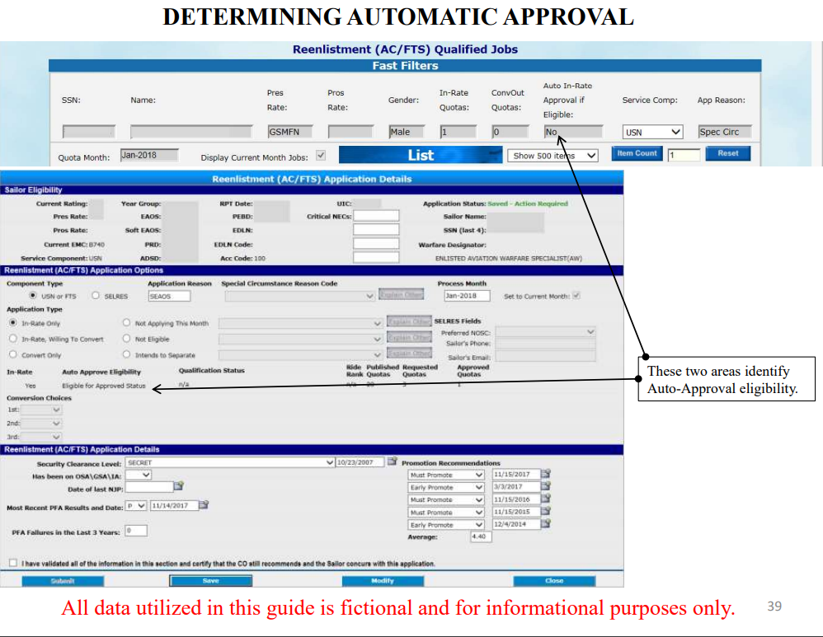
CWAY Auto Approval and Manning Categories
Notes:
FACILTIATOR GUIDE:
Although CWAY applications have been streamlined, to include an auto approval process, it is important to still understand that the applicable manning categories will come into play should the Navy reach desired manning levels. Additionally, it is also important for CCs to have an understanding of some of the information that goes into the auto approval/approval process.
2. CWAY applications are racked and stacked (a comparisons amongst records) and from this process, the following addressed and accessed for CWAY final approval; Rate manning levels, critical NECs, year groups (YG), PFA status, and record of non-judicial punishment (NJP) and CO’s recommendation.
** The following will require for actual CC review ** Do not assume that your applications will automatically be submitted and approved in a balanced or competitive manning environment.
Rate manning categories are as follows:
Open Reenlistment: Undermanned skill sets (97.9% or less manning).
Balanced Reenlistment: Fully manned skill sets (98% to 102% manning).
Competitive Reenlistment: Overmanned or Special Requirement skill sets (102.1% or greater manning).

Slide 13
RETURN CWAY QUOTA
Notes:
FACILIATOR GUIDE:
1. If a Sailor intends to separate or go SELRES, after counseling is complete by the CCC generate a Page 13 and verify in NSIPS/CIMS. Hard copy documentation should be files and NOT forwarded to NPC/BUPERS, unless specifically requested.
2. To return the quota, hover over Sailors, Sailor browser, highlight requested Sailor in blue, click on reenlistment application, choose from the drop down return quota reason and you can either save the application for additional updates later or submit application and voluntarily return CWAY quota.
3. If your Sailor later intends to stay Navy for an In-rate quota or a SELRES application. Go to the reenlistment application browser and unsubmit the Intends to separate application. Next, update the application and submit per Sailors' desires. If CWAY is not allowing you to submit an application for SELRES due to "Intends to separate" contact the CWAY helpdesk for a CWAY RESET FOR SELRES at career_waypoints@navy.mil or CWAY Admin support desk- (901) 874-2102; DSN 882-2102.

Slide 14
CWAY Process and Timeline Requirements Cont…
Year Group (YG)
ADSD – 01 OCT 22= YG 23
ADSD – 30 SEP 22 = YG 22
CWAY allows the CCC to counsel and guide Sailors toward new career opportunities and rating conversions
Notes:
FACILITATOR GUIDE:
A Sailor's year group (YG) is determined by the Fiscal Year (FY) of when the Sailor joined the Navy (go over example on slide). CCCs use CWAY to determine the best available ratings (once qualified) for E6 and below Sailors.

Slide 15
SEAOS Streamlined mode
Notes:
FACILITATOR GUIDE:
Review slide

Slide 16
PRD Streamlined mode
Notes:
FACILITATOR GUIDE:
Review slide

Slide 17
Targeted Reentry Program (TRP)
MILPERSMAN 1001-260
COs have the ability to recommend their most qualified Sailors the option for expedited re-entry to Active Duty
Sailor Options:
Golden Ticket
Silver Ticket
CCCs will submit TRP applications in CWAY:
Must be the first CWAY application window and submitted as: Intend to Separate
Notes:
FACILTIATOR GUIDE:
1. Golden ticket guaranteed expedited return within one year of separation, after one year will automatically be converted to a Silver ticket for one additional year. Silver ticket Sailors are afforded an expedited return within two years of separation, opportunity is subject to Needs of the Navy.
2. Eligibility: applications must be "Intends to separate" from the onset of the SEAOS application. Members in paygrades E4-E6, must have completed their eight year military service obligation (MSO), be under 14 years of service, and not have reached HYT. BUPERS-3 is the approving authority. Must have neither been awarded NJP or court martial within 3 years prior to release. Sailors who are approved and accept TRP will be transferred to the Standby Reserve- Inactive (USNR-S2).
3. After TRP expiration and MSO is not complete, the service member must accept enlistment into the Individual Ready Reserve active status pool (IRR-ASP).

Slide 18
Other C-WAY Modules
Job Opportunities in the Navy (JOIN)
Allow Sailors to complete survey to determine career interest
Ranks each job base on survey completion
Career Exploration Module (CEM)
Great tool when conducting conversion CDB’s
Allows counselors to determine why a Sailor did not qualify for a particular rate
Notes:
FACILITATOR GUIDE:
1. Join is a job interest assessment tool that supports recruits and Sailors making rating entry decisions.
2. CEM assists in determining correctable deficiencies that would otherwise render Sailors ineligible for desired ratings (e.g., retake the Armed Forces Classification Test (AFCT)- the in-service version of the ASVAB). The CEM module also provides Sailors with a roadmap for each job they qualify for.
3. Both of the above modules, can be found in the CWAY self-service system via BOL (under my opportunities and my interest).

Slide 19
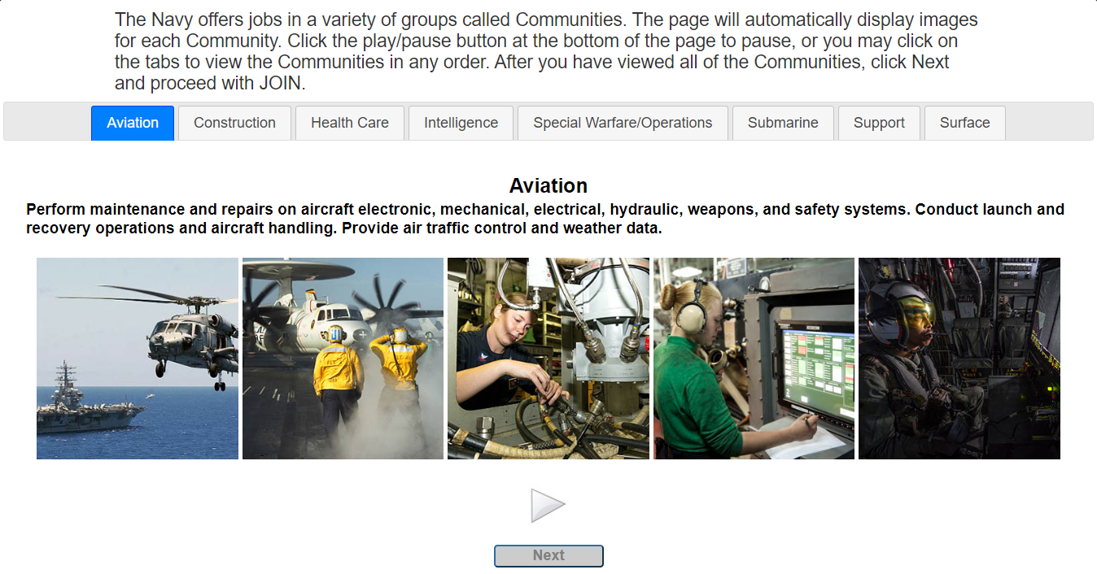
Job Opportunities in the Navy (JOIN) Survey
Notes:
FACILITATOR GUIDE:
Access via BOL. Great tool to assess interest and ranking of rates.

Slide 20
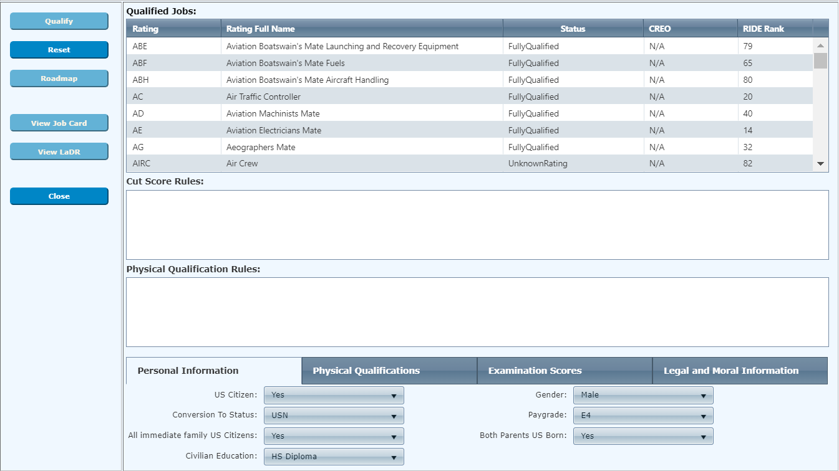
Career Exploration Module
Notes:
FACILITATOR GUIDE:
Review CEM module

Slide 21
AFCT Retesting
MILPERSMAN 1236-010
CO authorization
Must show academic improvement by completing one of the following before retaking:
Have H.S. diploma, GED, or passed the U. S. citizenship test
Complete the Online Academic Skills Course (OASC) through DANTES
Complete a college or correspondence course
New scores will be updated in the Enlisted Master File after processing.
Notes:
FACILITATOR GUIDE:
AFCT test results will be available in member's NSIPS within 30 days of testing. Personnel may retake the AFQT no less than 30 days from last test.
NOTE: The new AFCT score will overtake the current score.

Slide 22
PACT Marketplace
Notes:
FACILITATOR GUIDE:
Example of PACT Marketplace schedule. Ensure to retrieved the current FY timeline prior to briefing the slide.

Slide 23
CWAY/PACT Marketplace Menu
Notes:
FACILITATOR GUIDE:
To access PACT Marketplace Browser, hover over Sailors, then PACT marketplace record browser.

Slide 24
PACT Marketplace Record Browser
Notes:
FACILIATOR GUIDE:
1. Default setting will be on current cycle. CCC can filter for future cycle or past cycles.
2. Note that future cycles will be available once the current cycle has closed. Check the CWAY webpage via MyNavy HR or schedule.
3. CCC is able to filter and select preferred status i.e. approved, denied, or transmitted to MNA. CCC can also locate a Sailor via one of the three filters: SSN, DOD ID number, or by name.

Slide 25
PACT Marketplace Record Browser
Notes:
FACILITATOR GUIDE:
1. Any Sailor that does not have a date in the "JOIN date" has not taking the survey.
2. If there is a "NO" in the qualified column then the Sailor needs to be qualified in CWAY (please see slide 10 in this power point presentation).

Slide 26
PACT Marketplace Record Browser
Notes:
FACILITATOR GUIDE:
To view Sailors record history click on "record history". Click "Record details" to access PACT marketplace record.

Slide 27
PACT Marketplace Record Browser
Notes:
FACILITATOR GUIDE:
1. The center box, pops up if a Sailor has not been "qualified" and an attempt to access their record details is performed.
2. An "alert" stating Sailor needs to be qualified in CWAY. At this time proceed to qualifying the Sailor in CWAY.

Slide 28
PACT STATUS DEFINITIONS
Notes:
FACILITATOR GUIDE:
Review definitions

Slide 29
PACT RECORD DETAIL
Notes:
FACILITATOR GUIDE:
When the CCC selects request participation, the Sailor is requesting to participate in the PACT marketplace. Once validated and "saved," the Sailor name and qualified jobs are sent to My Navy Assignment (MNA). When the next MNA cycle opens, the Sailor will be able to apply for PACT jobs.

Slide 30
PACT Request To Remain Onboard
Notes:
FACILITATOR GUIDE:
On the PACT marketplace record details screen, there are three choices: request participation, requests to remain onboard, declines participation, or not eligible. If the Sailor requests to remain onboard, work with your Activity Manning Manager (AMM) to identify potential ratings with valid vacant billets to maximize the potential for the request to be approved to remain onboard.

Slide 31
PACT Remain Onboard
Notes:
FACILITATOR GUIDE:
When the CCC selects requests to remain onboard the Sailor is requesting to remain at current command. Sailor can submit up to four choices, next the user will check the validation box, and click save.

Slide 32
PACT Declines Participation
Notes:
FACILITATOR GUIDE:
If member is submitted as "declines participation" you can choose one of the following four reasons: not qualified for desired ratings, undecided on intentions, intends to separate, or submitting for a rate which requires a package to ECM.

Slide 33
PACT Not Eligible
Notes:
FACILITATOR GUIDE:
If member is submitted as "NOT ELIGIBLE" you can choose one of the four following reasons: legal/moral disqualifies, performance, discipline, or not ready for designation.

Slide 34
PACT Notes
Be sure to check eligibility status monthly and make updates as soon as possible
For example, member cannot obtain security clearance due to not being a U.S. Citizen. Once member becomes a U.S. citizen, this must be updated in CWAY to render member eligible
Same applies for “declines participation”. If member changes their mind later on, be sure updates are made before the next MNA cycle.
Notes:
FACILITATOR GUIDE:
None.

Slide 35
KNOWLEDGE CHECK
What are some reasons a PACT Sailor will not be eligible for Marketplace?
When can a Sailor retake the AFQT?
Timeline for processing PRD CWAY quota?
When are CWAY applications auto populated?
Notes:
ANSWERS:
1. Legal/moral disqualifies, performance, discipline, or not ready for designation.
After receiving CO approval and has met one of the following to demonstrate academic improvement:
Have H.S. diploma, GED, or passed the U. S. citizenship test
Complete the Online Academic Skills Course (OASC) through DANTES
Complete a college or correspondence course
3. PRD applications are processes 15 to 13 months prior to PRD
4. 18 months prior to SEAOS/PRD

Slide 36
Summary and Review
In this lesson we discussed:
Purpose of Career Waypoints
Personnel impacted by the Career Waypoints process
Career Waypoints process
Career Waypoints options provided to the Sailor
Career Waypoints timeline requirements
PACT Career Waypoints and PACT Marketplace process

Slide 37
Career Waypoints/PACT

